Slide 1
Magnetism

Slide 2
4. What is magnetism?
Iron, cobalt and nickel are the metals that can act like magnets or be attracted by magnets.
A MAGNET is an object that can attract other objects containing iron, cobalt or nickel.
MAGNETISM describes all the phenomena caused by magnets.

Slide 3
4.1 Magnets
Certain substances can act like magnets or not, while other substances never act like magnets.
Microscopically, iron is made up of a set of regions called domains, each acting like a tiny magnets with its own north and south poles.
When iron is not magnetised the domains are not aligned.
When the iron is magnetised the domains fall into alignment; the greater the number of aligned domains, the more powerful the magnet.

Slide 4
4.1 Magnets

Slide 5
Magnetic forces of attraction and repulsion
All magnets have a north-seeking and a south-seeking pole.
The NORTH POLE of a magnet is the end that naturally seeks the Earth’s magnetic pole near the geographic North Pole. The other end of the magnet is its SOUTH POLE.
If a magnet is broken into pieces, each piece has its own north and south pole.
Opposite magnetic poles attract each other.
Like magnetic poles repel each other.

Slide 6
4.2 Magnetic Fields
A MAGNETIC FIELD is the area of space in which the magnetic force of a magnet can act on another magnet.
Magnetic field lines are drawn coming out a north pole and entering into a south pole.
Lines are closest to one another near the poles because the poles are the areas of greatest magnetic intensity.
The shape of a magnetic field depends on the shape of the magnet.

Slide 7
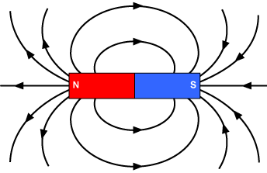
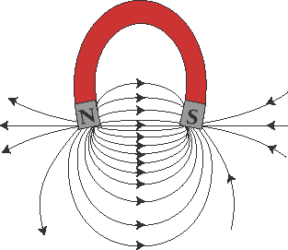
4.2 Magnetic Fields

Slide 8
Magnetising Objects
Magnetite is a natural magnet, but it is also possible to make artificial magnets with objects containing iron, nickel or cobalt by exposing them to the magnetic field of another magnet.
A FERROMAGNETIC SUBSTANCE is a substance with the ability to acquire magnetic properties.
A magnet can be demagnetised by a strong, sharp blow (e.g. dropping), by heating or by placing it in a magnetic field of opposite polarity.

Slide 9
Magnetising Objects
MAGNETIC REMANENCE describes the ability of a material to acquire and conserve magnetic properties.
Magnets that have a low magnetic remanence (e.g. iron containing few impurities) are called temporary magnets.
Magnets that have a high magnetic remanence (e.g. steel, which is an iron carbon alloy) are called permanent magnets.

Slide 10
5. Electromagnetism
ELECTROMAGNETISM describes all the phenomena resulting from the interaction between electricity and magnetism.

Slide 11
5.1 Magnetising by electricity
To generate a magnetic field using electricity, the electrical charges must be in motion (dynamic electricity) and the magnetic field only lasts as long as the current flows.
Magnetic Field of a Live Wire
Magnetic field lines form circles around live wires and the direction depends on the current direction.

Slide 12
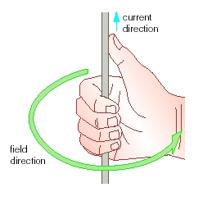
5.1 Magnetising by electricity
To determine the direction of the magnetic field lines generated by a live wire, we use the “right-hand rule”:
+

Slide 13
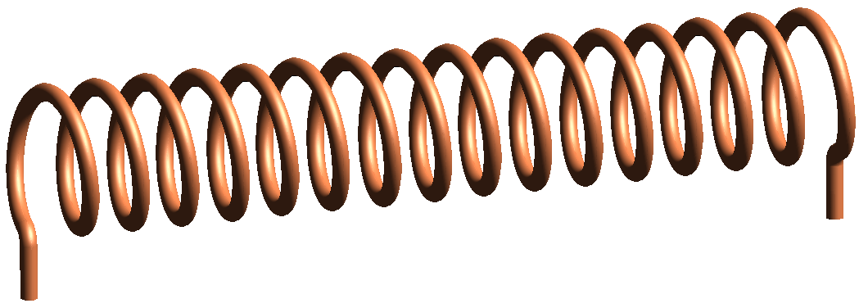
5.1 Magnetising by electricity
Magnetic Field of a Solenoid
The magnetic field of a straight live wire can be intensified if the wire is rolled into a coil of regularly shaped loops called a solenoid.
The intensity of the magnetic field is highest in the center of the cylinder.
+

Slide 14
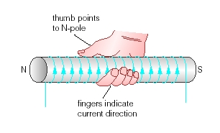
5.1 Magnetising by electricity
Magnetic Field of a Solenoid
To determine the direction of the magnetic field lines of a solenoid, we use “another right-hand rule”:
+

Slide 15
5.1 Magnetising by electricity
Three differences distinguish the magnetic field of a solenoid from that of a bar magnet:
The magnetic field of a solenoid can be turned “on” and “off” – not the case for a bar magnet.
The direction of the field lines of a solenoid can be altered by reversing the current direction – the magnetic field lines of magnet cannot be reversed.
The intensity of the magnetic field of a solenoid can be modified - not the case for a bar magnet.

Slide 16
Electromagnets
To transform a solenoid into an electromagnet, a ferromagnetic substance is inserted inside the solenoid creating a core.
The magnetic field of the electromagnet comes from both the current of the solenoid and the magnetization of the core material.
The result is a powerful magnet that can be turned “on” or “off”.

Slide 17
Electromagnets
The power of an electromagnet can be increased in three ways:
increasing the intensity of the electric current flowing through solenoid
adding more loops to the solenoid
using a core material with a lower magnetic remanence

Slide 18
5.2 Charging by Magnetism
ELECTROMAGNETIC INDUCTION consists in generating an electric current in a conductor by varying a magnetic field around the conductor – can be achieved in two ways (refer to p. 171 in the textbook):
by moving a conductor inside a magnetic field
by moving a magnet with respect to a conductor
Widely used to transform mechanical energy into electrical energy (generator).

